Slide 1
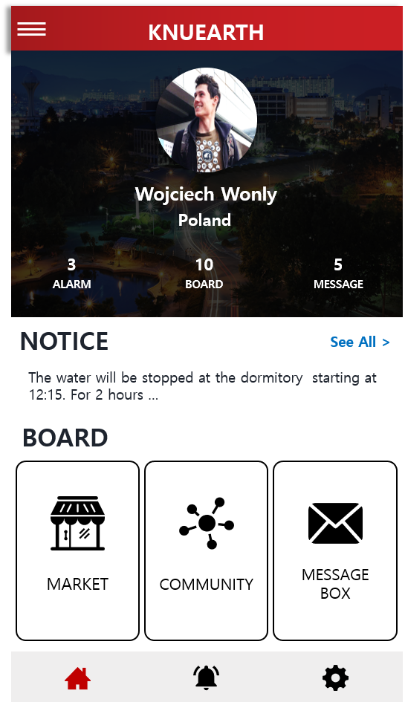


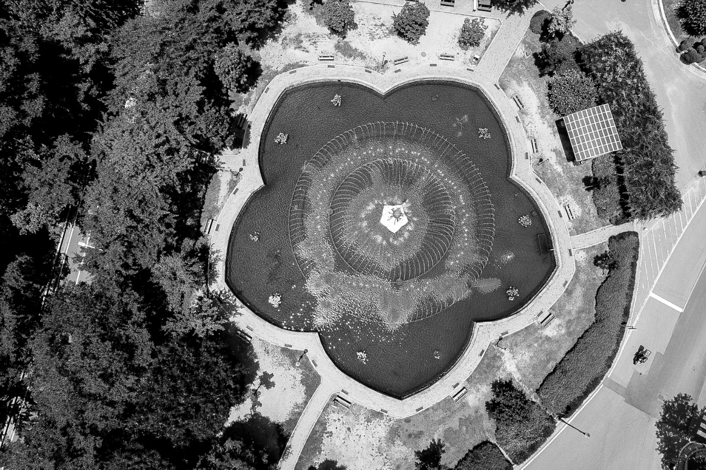




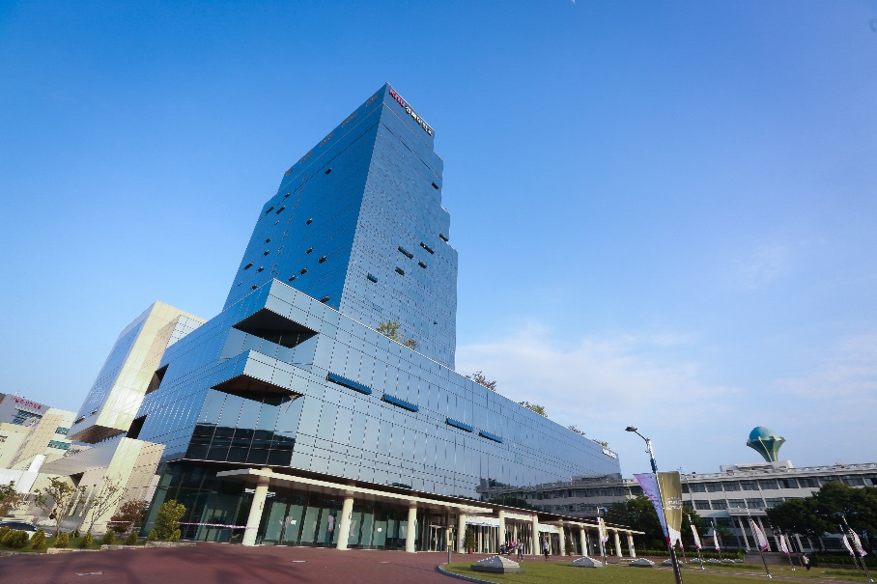
한국어
ENGLISH
TEAM 0x01
[ KNUEARTH ]
; THE LITTLE EARTH ON YOUR HAND
Community platform for international student based on Online to Offline
Community
Trading System
1,250,0000
외국인 교환학생을 위한
외국인 교환학생 커뮤니티 플랫폼
International students have the following problems.
32%
21%
17%
12%
10%
5%
언어문제
병원서비스
생필품 구매
문화교류
숙박
구인구직
KEYWORD
중고거래
Trade System
언어교환
Language
병원서비스
Hospital Service
문화교류
Culture
생활꿀팁
Living Tip
COOPERATION
경북대학교
국제교류처 버디시스템 서드파티 어플리케이션
부제목 SUBTITLE
International Exchange Buddy System
Third Party Application in KNU
THE LITTLE EARTH ON YOUR HAND
슬로건 SLOGAN
DON’T BE AFRAID | COME FIRST | ENJOY TOGETHER
2018 Capstone Design Project Team 0x01 | Contact us : KNU0x01@gmail.com | Cooperation site : 국제교류처

Slide 2

한국어
ENGLISH
TEAM 0x01
[ KNUEARTH ]
; THE LITTLE EARTH ON YOUR HAND
Community platform for international student based on Online to Offline
Community
Trading System
양옆 마진 20%
1,250,0000
외국인 교환학생을 위한
외국인 교환학생 커뮤니티 플랫폼
International students have the following problems.
32%
21%
17%
12%
10%
5%
언어문제
병원서비스
생필품 구매
문화교류
숙박
구인구직
KEYWORD
중고거래
Trade System
언어교환
Language
병원서비스
Hospital Service
문화교류
Culture
생활꿀팁
Living Tip
COOPERATION
경북대학교
국제교류처 버디시스템 서드파티 어플리케이션
부제목 SUBTITLE
International Exchange Buddy System
Third Party Application in KNU
THE LITTLE EARTH ON YOUR HAND
슬로건 SLOGAN
DON’T BE AFRAID | COME FIRST | ENJOY TOGETHER
2018 Capstone Design Project Team 0x01 | Contact us : KNU0x01@gmail.com | Cooperation site : 국제교류처

Slide 3
한국어
ENGLISH
COOPERATION
[ KNUEARTH ]
경북대학교
국제교류처 버디시스템 서드파티 어플리케이션
; THE LITTLE EARTH ON YOUR HAND
International Exchange Buddy System
Third Party Application in KNU
Community platform for international student based on Online to Offline
TEAM 0x01
Community
Trading System
부제목 SUBTITLE
THE LITTLE EARTH ON YOUR HAND
슬로건 SLOGAN
DON’T BE AFRAID | COME FIRST | ENJOY TOGETHER
2018 Capstone Design Project Team 0x01
Contact us : KNU0x01@gmail.com
Cooperation site : 국제교류처
1,250,0000
외국인 교환학생을 위한
외국인 교환학생 커뮤니티 플랫폼
International students
have the following problems.
32%
21%
17%
언어문제
병원서비스
생필품 구매
12%
10%
5%
문화교류
숙박
구인구직
KEYWORD
중고거래
Trade System
병원서비스
Hospital Service
언어교환
Language
문화교류
Culture
생활꿀팁
Living Tip

Slide 4
한국어
ENGLISH
COOPERATION
[ KNUEARTH ]
경북대학교
국제교류처 버디시스템 서드파티 어플리케이션
; THE LITTLE EARTH ON YOUR HAND
International Exchange Buddy System
Third Party Application in KNU
Community platform for international student based on Online to Offline
TEAM 0x01
Community
Trading System
부제목 SUBTITLE
THE LITTLE EARTH ON YOUR HAND
슬로건 SLOGAN
DON’T BE AFRAID | COME FIRST | ENJOY TOGETHER
2018 Capstone Design Project Team 0x01
Contact us : KNU0x01@gmail.com
Cooperation site : 국제교류처
1,250,0000
외국인 교환학생을 위한
외국인 교환학생 커뮤니티 플랫폼
International students
have the following problems.
32%
21%
17%
언어문제
병원서비스
생필품 구매
12%
10%
5%
문화교류
숙박
구인구직
KEYWORD
중고거래
Trade System
병원서비스
Hospital Service
언어교환
Language
문화교류
Culture
생활꿀팁
Living Tip

